Slide 1

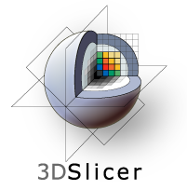
Introduction to 3D imaging and Morphometrics
A. Murat Maga
Associate Professor
University of Washington
Department of Pediatrics, Division of Craniofacial Medicine
&
Seattle Children’s Research Institute
Center for Developmental Biology and Regenerative Medicine
SlicerMorph Core Team:
Co-PI: Adam Summers (UW FHL)
Co-PI: Doug Boyer (Duke Evol. Anthropology & Director of MorphoSource.org)
Consultant: Steve Pieper (Isomics Co., Chief Software Architect of 3D Slicer)
Lead Developer: Sara Rolfe (UW FHL & SCRI)

Slide 2
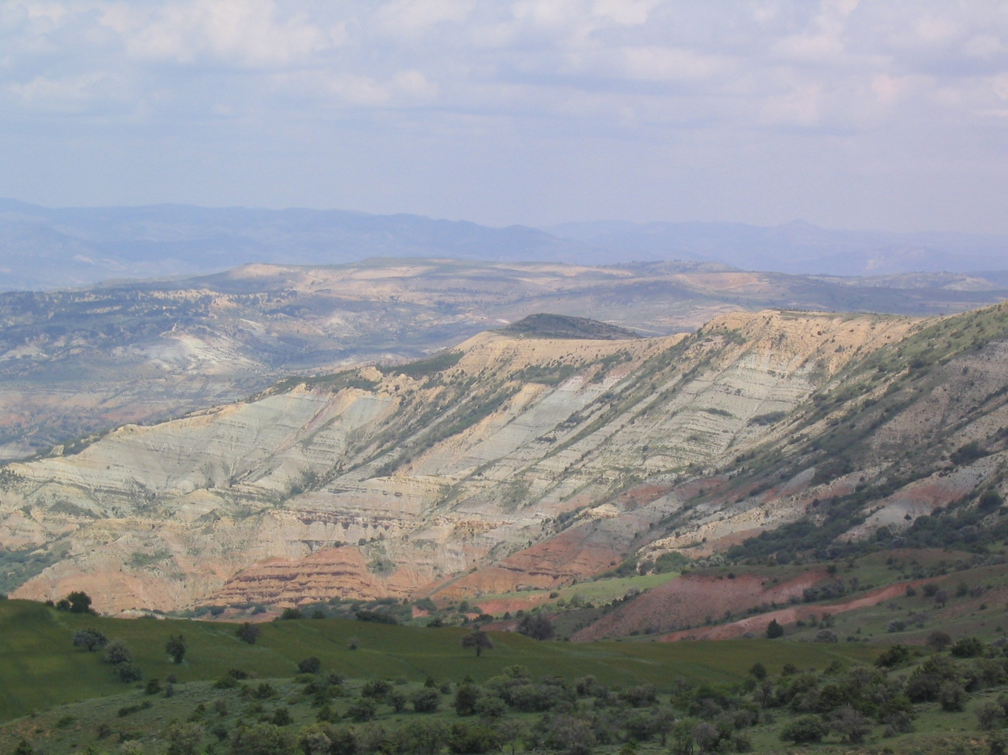
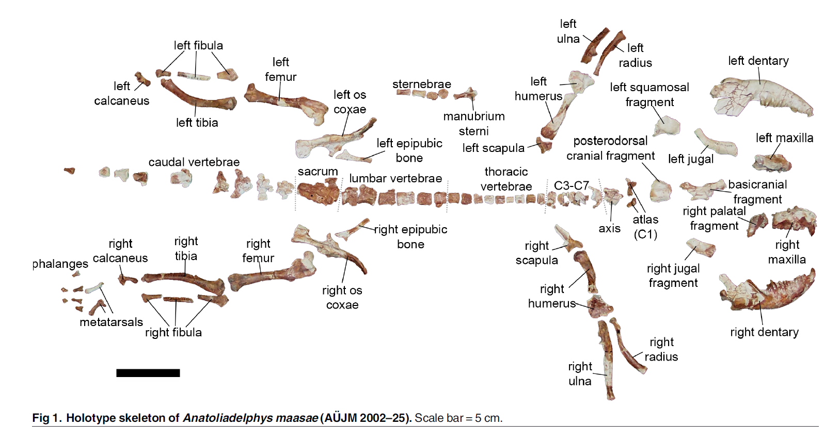
A marsupial in Turkey
Notes:
Before we begin, I have two little stories to tell that are related to our work at hand.
Before I became a faculty at the department of pediatrics, I was a paleontologist, working in sites like this.
Part of my dissertation was on fossil stem marsupial skeleton I collected from Turkey (dating about 50 million years ago).

Slide 3
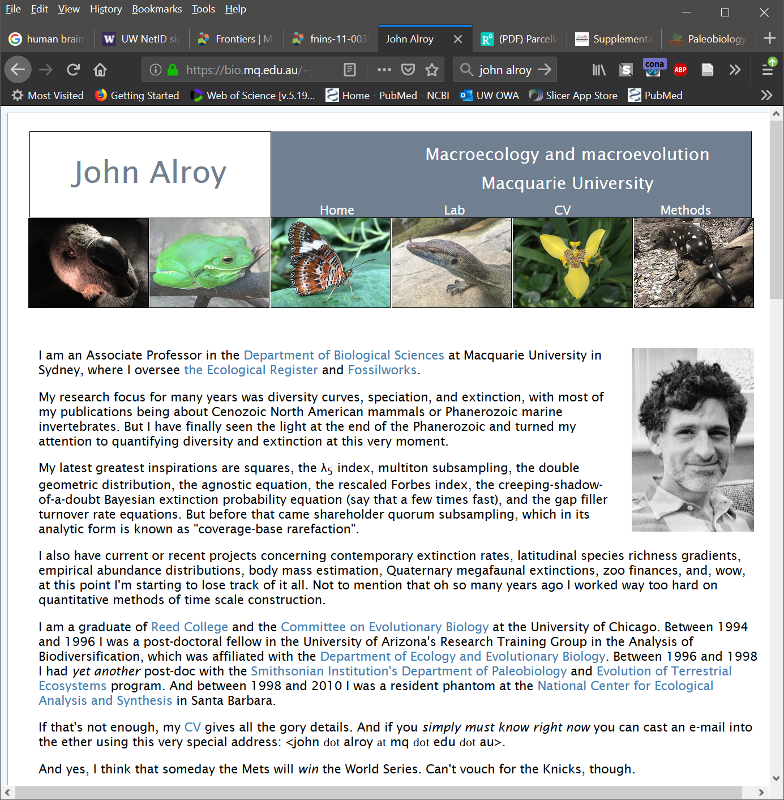
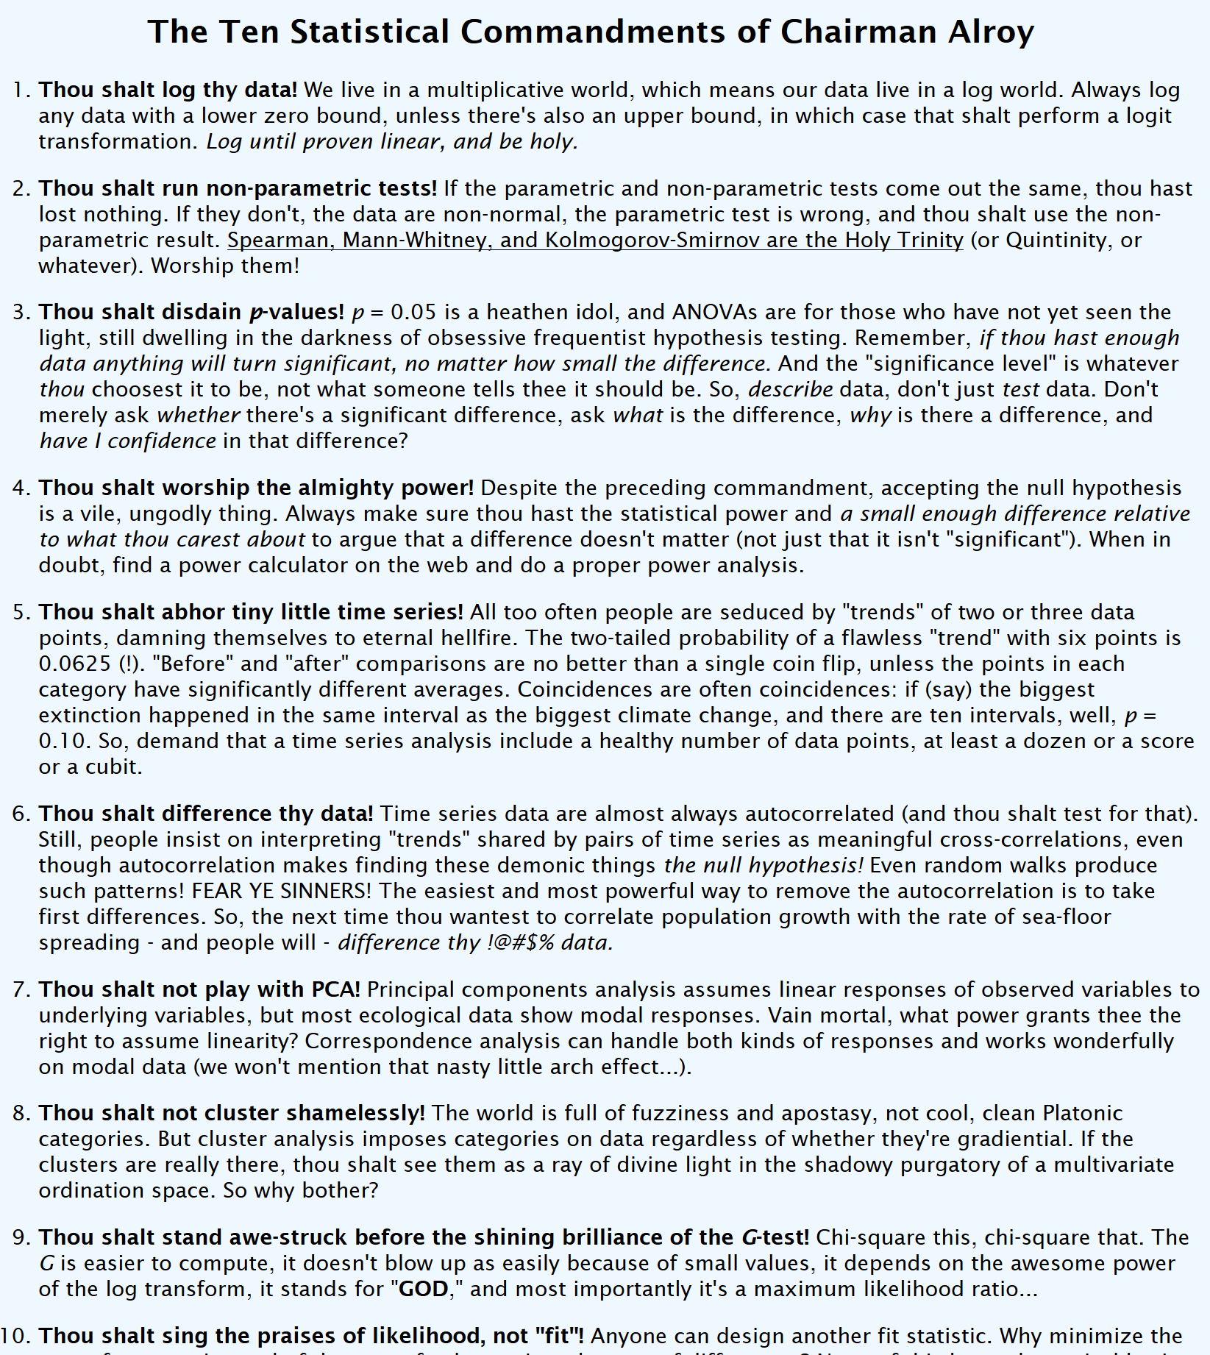
Workshops can be transformational!
https://www.nceas.ucsb.edu/~alroy/JA_commandments.html
Notes:
During around the time I was writing my dissertation, I participated in a quantitative palebiology workshop organized by Dr. John Alroy, was at the National Center for Ecological Analysis and Synthesis at Santa Barbara,
During those five weeks, I was introduced to quite a number of topics in paleoecology most of which I frankly don’t remember at the moment, however, geometric morphometrics that I learned during the workshop landed me my first post-doc and my eventual faculty position at UW and Seattle Childrens.
So workshops can be transformational especially for early career scientist, and we will strive to do as good a job too.

Slide 4
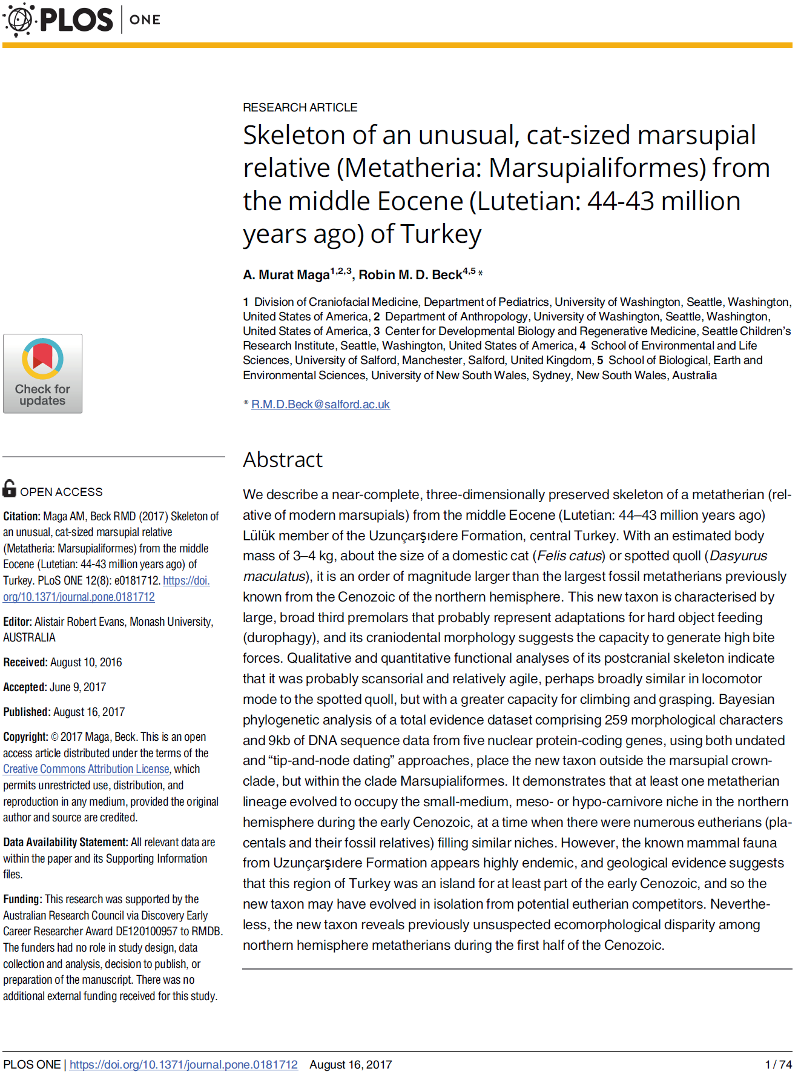
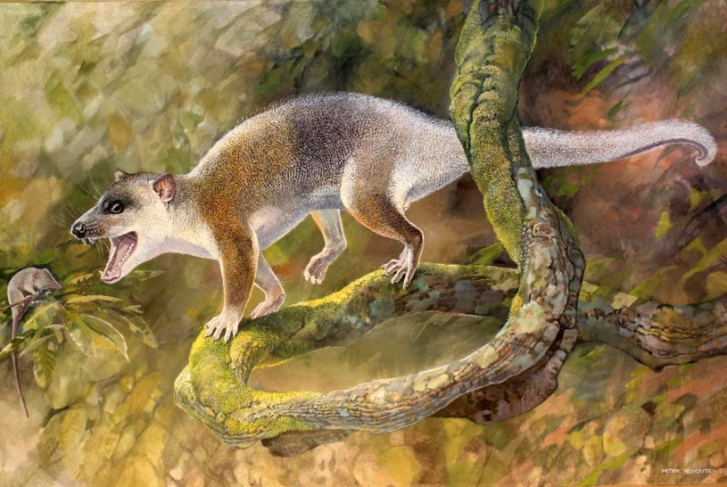
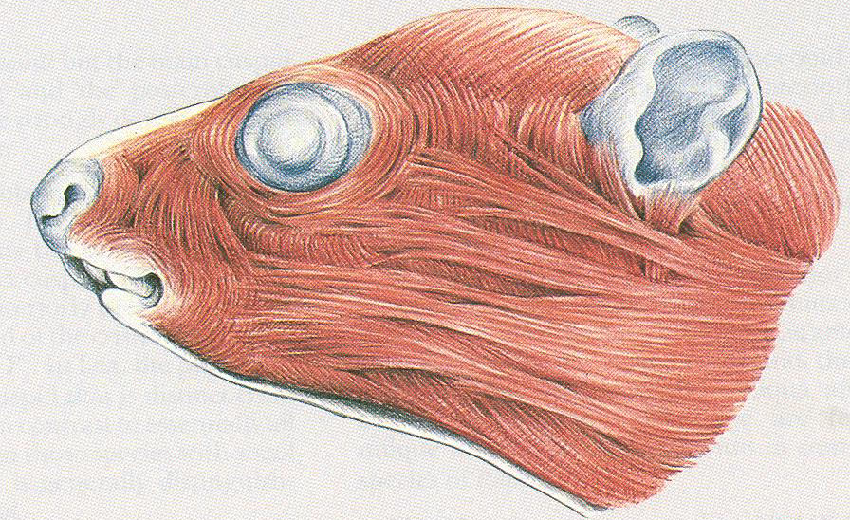
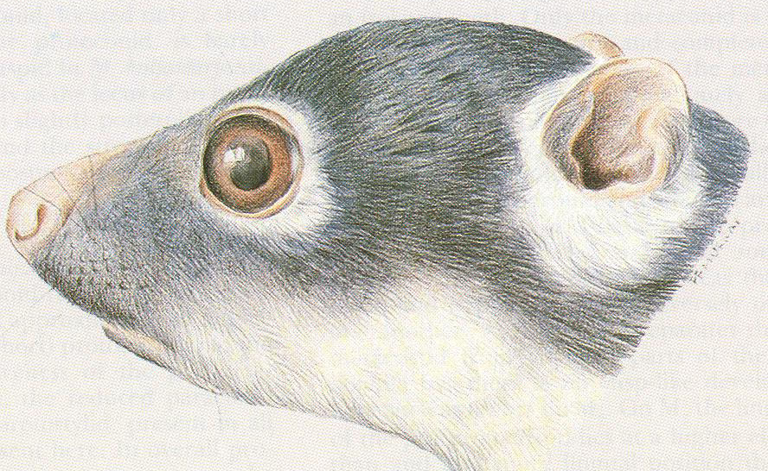
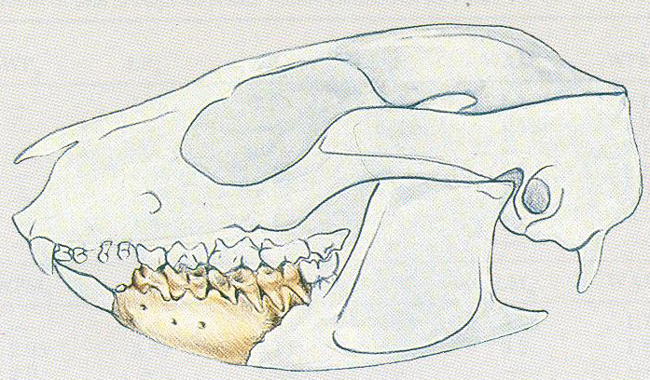
Anatoliadelphys maasae
Illustration by Coco Kishi
Illustration by Peter Schouten
Woodburne et al. 1987. New Miocene ringtail possums from South Australia
Notes:
As I told you before I worked on this fossil marsupial skeleton, which is finally published after a short 10 year hiatus. We have done a visual reconstruction of the skeleton of this not-so-little guy (about the size of a Tasmanian devil), and if you think we have gone overboard, you clearly haven’t talk to or worked with paleontologists, who tends to have very creative when it comes to interpreting the specimens they discover.
While the 10 year delay was partly due to my career shift, it was also related to the fact that I had no longer had access to all the digital work I have done at the University of Texas at Austin as a graduate student, because I couldn’t afford to buy VG Studio Max where I did all my dissertation work on 3D scans. With the career change I cannot bring myself to reinvest all the time I sunk into segmenting and cleaning up the fossil fragments.
As I was a starting my lab own lab about 8 years ago, I made a decision not to invest into the commercial software packages for 3D image analysis and since than I didn’t look back.
It takes time and effort, but it was an investment that paid off well for me, as I managed to establish different collaborations and get to work on many different interesting projects.

Slide 5
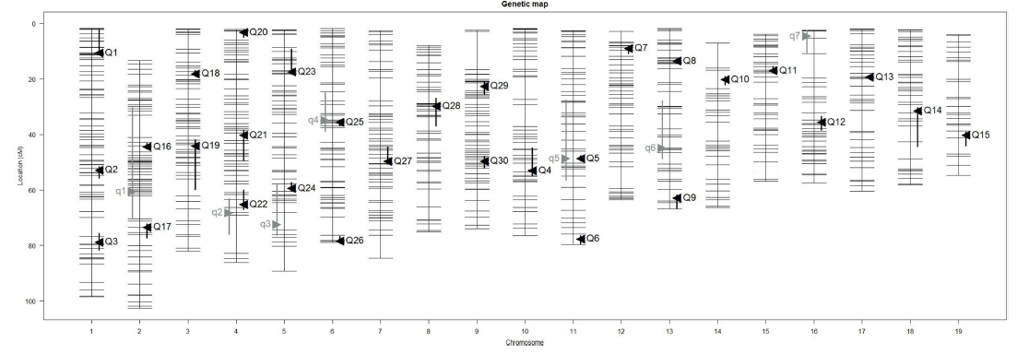
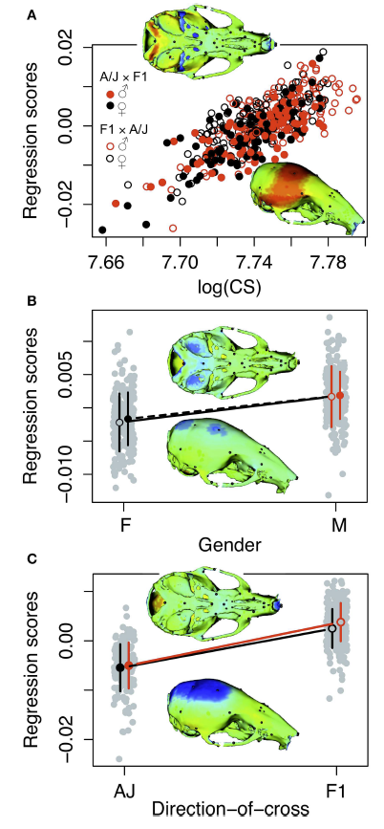
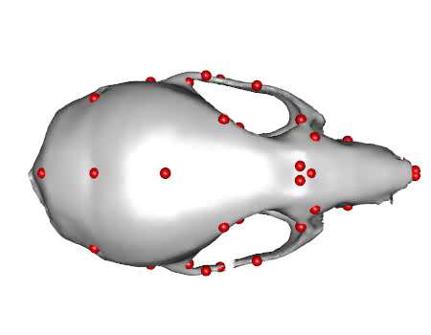
Unfolding the genotype/phenotype map in craniofacial system
Maga AM, et al. 2015. Quantitative trait loci affecting the 3D skull shape and size in mouse and prioritization of candidate genes in-silico. Frontiers in Physiology | Craniofacial Biology 6:92.
Navarro N, Maga AM. 2016. Does 3D Phenotyping Yield Substantial Insights in the Genetics of the Mouse Mandible Shape? G3: Genes, Genomes, Genetics 6:1153–1163.
Navarro N, Maga AM. 2018. Genetic mapping of molar size relations identifies inhibitory locus for third molars in mice. Heredity 121:1–11.
Notes:
In my lab, we are interested in a very fundamental biological question, which is unfolding the genotype/phenotype map for the craniofacial skeleton. What is the genetic architecture that controls for the skull shape, how many genes are involved, what are they, which aspects of the skull shape each individual locus determines. We use lab mouse, to derive genetic panel of various crosses and then use 3D morphometrics to look at the statistical maps between 3D shape and genetic map. So far we have done this for skull, mandible, and molar tooth.

Slide 6
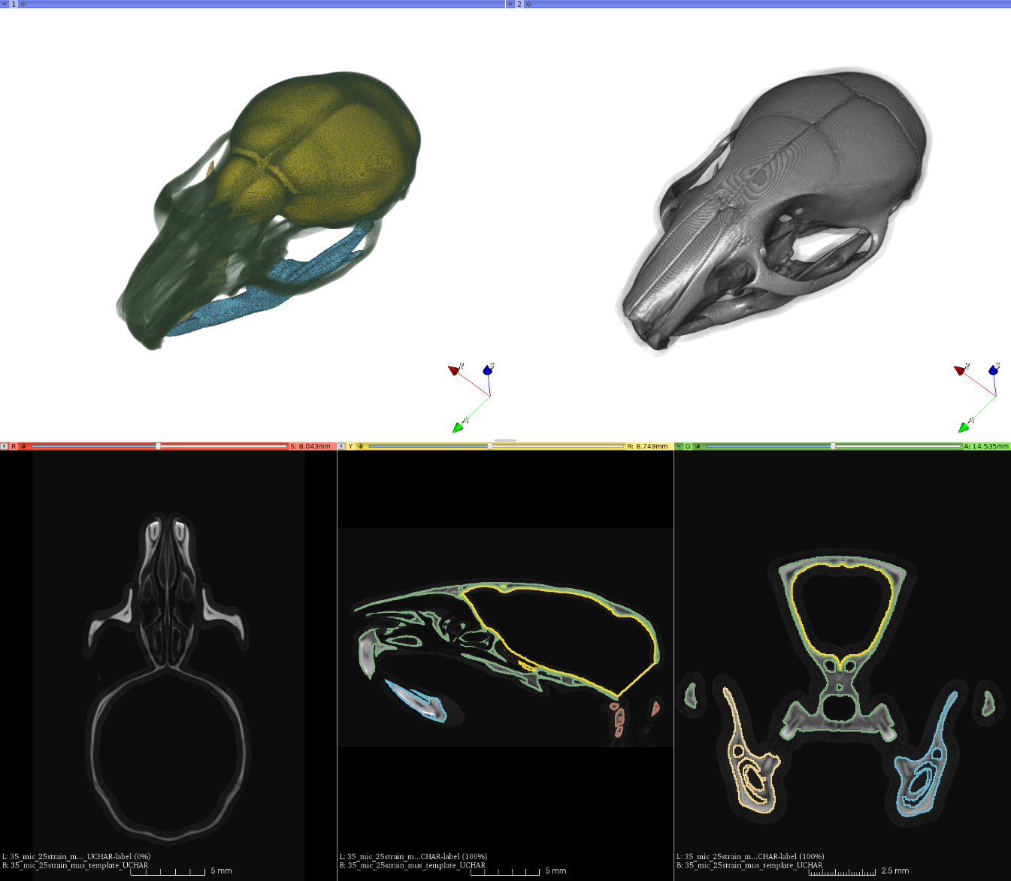
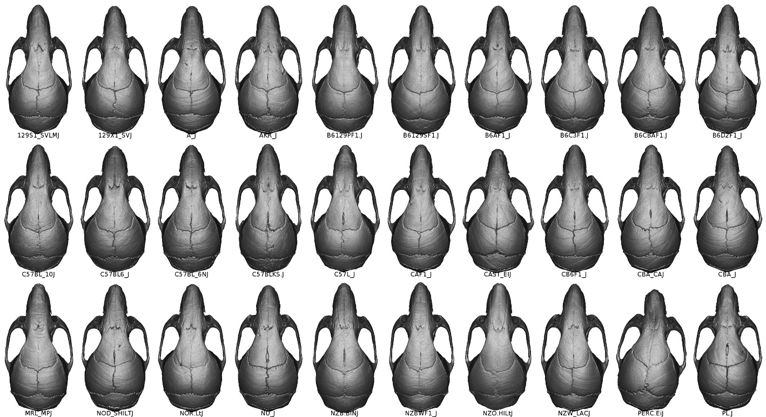
Image-based analysis (registration & segmentation)
Young R, Maga AM. 2015. Performance of single and multi-atlas based automated landmarking methods compared to expert annotations in volumetric microCT datasets of mouse mandibles. Frontiers in Zoology 12:33.
Maga AM, Tustison NJ, Avants BB. 2017. A population level atlas of Mus musculus craniofacial skeleton and automated image-based shape analysis. Journal of Anatomy 231:433–443.
Notes:
One of the challenges we faced, was the requirement of having very large-sample sizes (on the order of 400-1000) for QTL mapping and conducting landmark-based 3D phenotyping. It takes long, and has some variability issues (which we will discuss briefly tomorrow). So, again leveraging some of the innovative work done in the human neuroimaging domain and open-source image analysis tools, we developed methods that aid us in this quest.

Slide 7
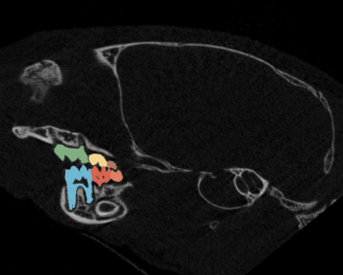
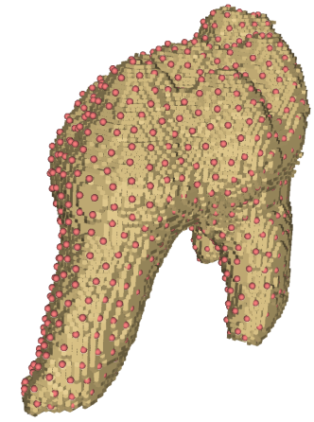
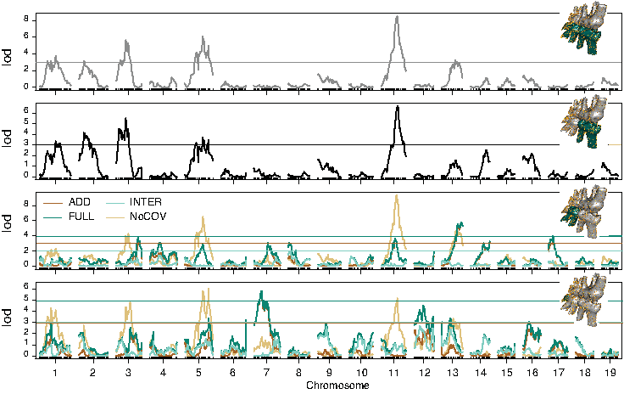
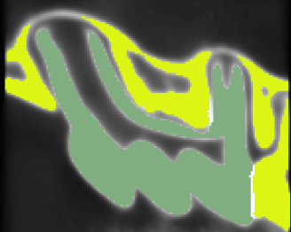
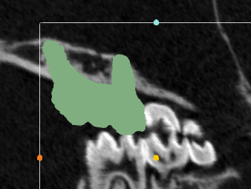
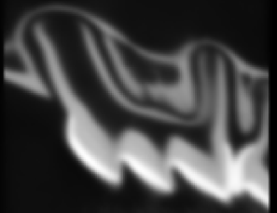
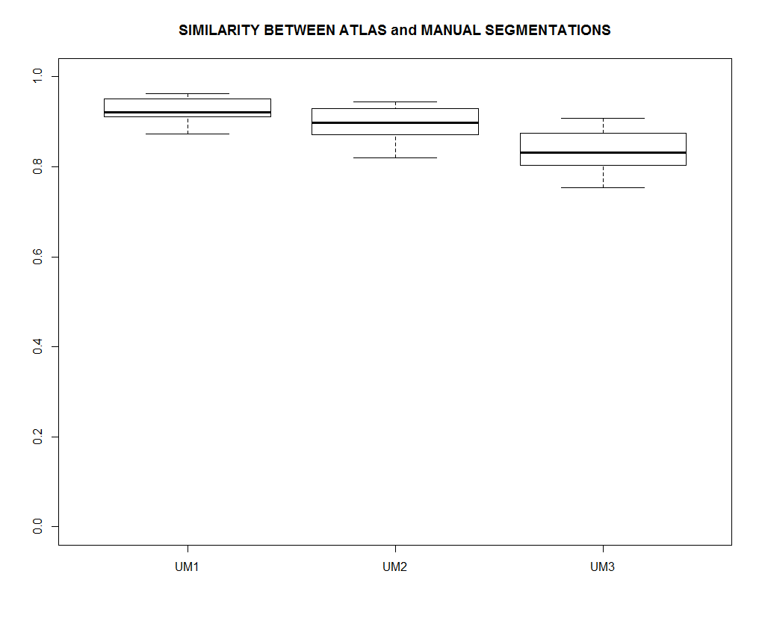
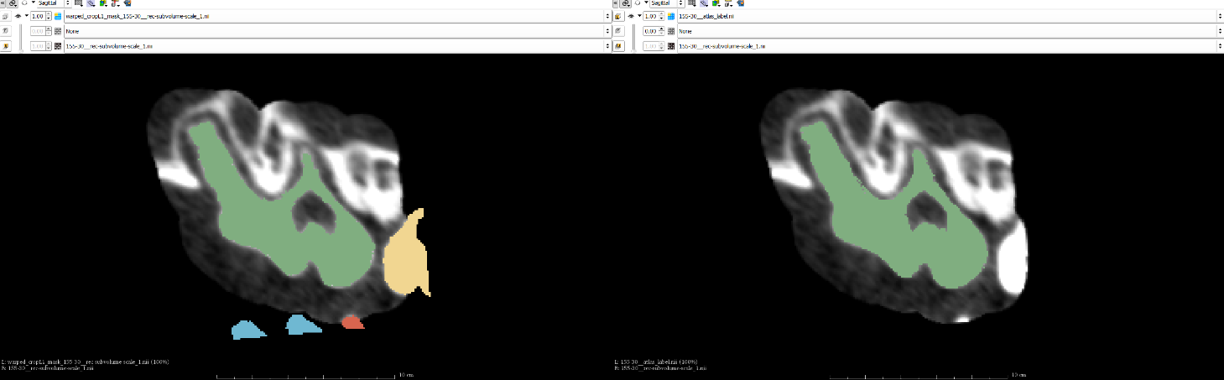

Genetic control of 3D molar size
Initial segmentation
Segment Atlas
Transfer and Mask
Indiv. Atlases for molars
Atlas Validation
Pipeline for automated segmentation of 2,500 molars from more than 400 mouse scans
1.0
0.8
0.6
Similarity Score
Navarro N, Maga AM. 2018. Genetic mapping of molar size relations identifies inhibitory locus for third molars in mice. Heredity 121:1–11.
0.4
0.2
0.0
Manual
Atlas-Based
Notes:
For example, to identify QTL that govern molar size relationships in mice, we had to segment almost 2500 hundred individual molars in 3D to obtain precise 3D size and shape of the individuals. A template-based analysis, that we will take a look at on day 3 was quite helpful in this context.

Slide 8
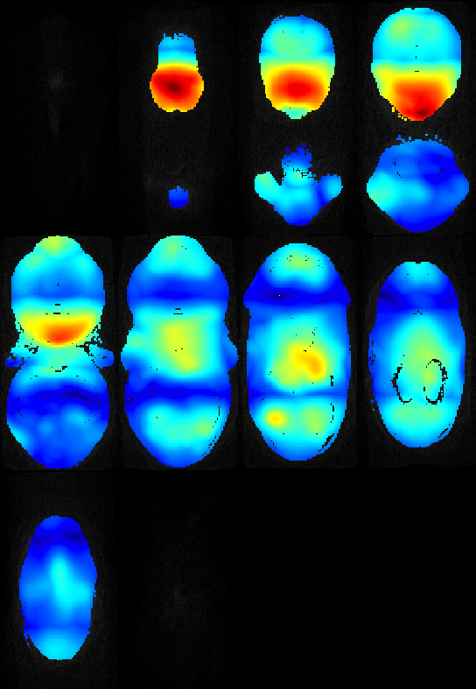
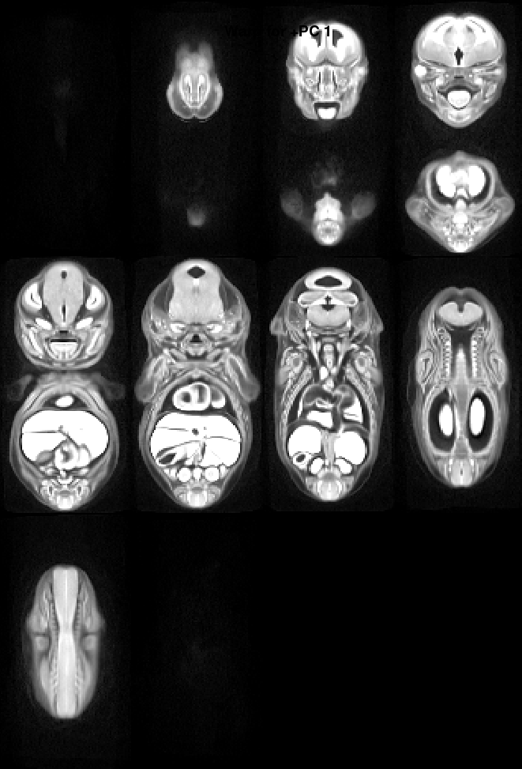
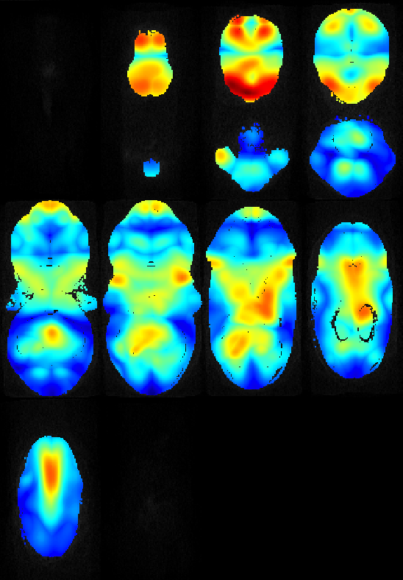
PCA as a tool for exploratory analysis in mouse screens
Fetal Alcohol Exposure Induced Developmental Variability
Control mice fetuses at E15
Study template
(Population average)
E15 fetuses from dams consumed 10% v/v EtOH ad-libidum during the first 8 days of pregnancy (E0-E8)
Maga lab unpublished data (undergrad project)
Notes:
Gross morphological screens, whether for genetics or developmental toxicology is an important aspect of developmental biology. With some basic image analysis, we can show increased phenotypic variability in the litters in the toxicology survey that will probably go undetected in a dissection. Or can actually help automate certain aspects of the screens.

Slide 9
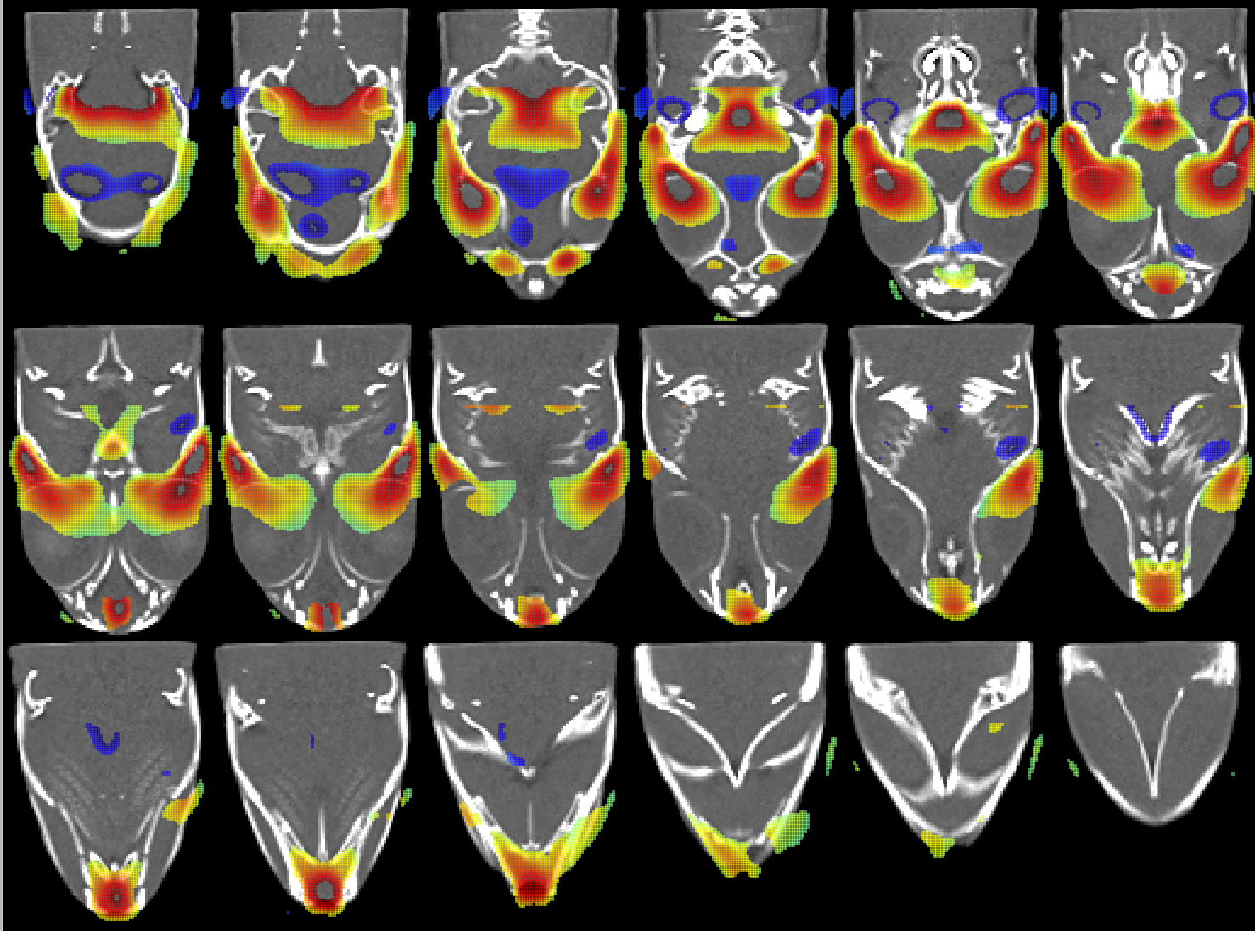
Littermates vs bmp1a mutants growth differences
Warmer colors, regions significantly shrunk in mutants compared to littermates
Colder colors, regions significantly enlarged in mutants compared to littermates
Bhimani RM, Watson CJ, Maga AM, Kwon RY. 2019. FishCuTv2: An Extensible Software for microCT-Based Whole-Body Skeletal Phenomics in Zebrafish. Annual Meeting of Orthopaedic Research Society. Austin, TX
Notes:
Basically every analysis and picture presented in the last 3-4 slide were done using a combination of various open-source biomedical visualization tools like 3D Slicer, and data analysis platforms like R and/or Python, and more importantly can be reused by colleagues and collaborators. That’s our goal in this workshop is to give you the pointers to help yourselves in the broad field of 3D morphometrics and establish a community around it.

Slide 10
Maga Lab is hiring! Two open post-doc positions
Postdoc in Genetics of Craniofacial Shape and Form
This NIH funded project is aimed at using computational anatomy and 3D morphometrics to understand the genetic structure of craniofacial shape and form using inbred strains of mice .
Qualified candidates are expected to have a strong background in craniofacial biology and development, or in quantitative genetics and bioinformatics. Preference will be given to candidates with experience conducting genome-wide efficient mixed-model association studies.
Proficiency with R or python is mandatory. This is a one-year position, with an option to renew for one more year based on performance and available funding.
Expected start date is October 1st 2019 (or sooner).
Postdoc in Machine Learning in 3D Image Analysis
This NSF funded position is a collaborative project between five institutions (University of South Dakota, Seattle Children’s, Virginia Tech, Drexel, and Tulane) to develop biology-guided convolution neural nets to enable machine discovery of organismal traits using existing 2D and 3D annotated imagery from aggregate specimen archives, as well as existing information from developmental and anatomical ontologies and phylogenies.
Post-docs in the project will have a chance to cross-train in different fields of phylogenetics, vertebrate morphology (ichthyology in particular), data-science and machine learning through rotations in participating sites.
For the project at Magalab, we are seeking trainees that either have PhDs in computer vision (or related) research and interested in applying their research in organismal biology context, or biologists with a strong computational background interested in learning image analysis. This is a two-year position, with an option to renew based on performance and pending project renewal.
Expected start date is December 1st 2019 (or sooner).
http://faculty.washington.edu/maga/post-docs/
Or email maga@uw.edu

Slide 11
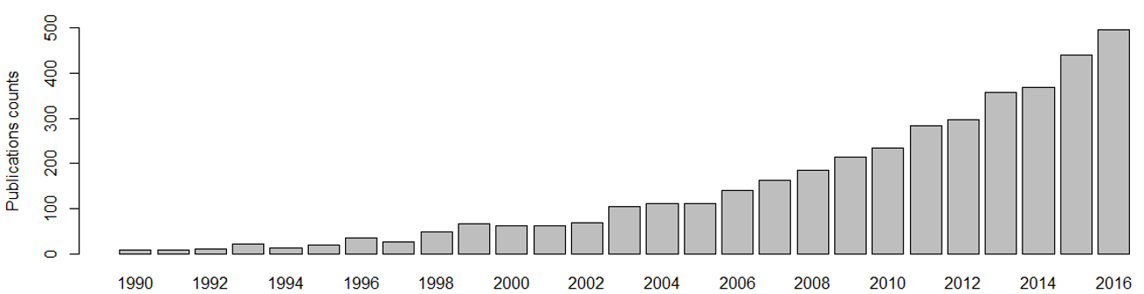
Quantitative Analysis of organismal form via geometric morphometrics is booming.
Data from Web of Science. Topic keywords: ‘geometric morphometrics’ OR procrustes
Notes:
In the last 10 years or so, we are seeing this exponential increase in the number of publication that use geometric morphometrics methods in context of organismal biology studies. Mind that most of these based on 2D analysis of pictures.

Slide 12
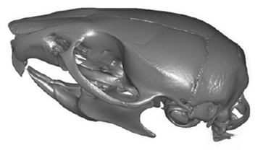
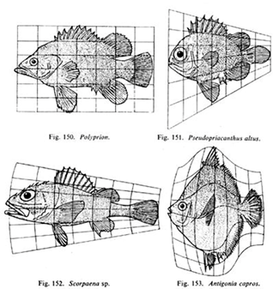
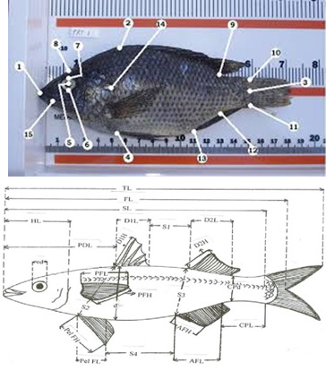
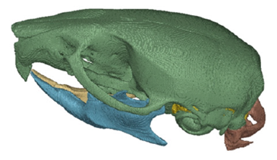
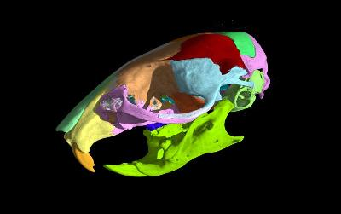
Moving beyond state-of-art and why now?
1900s
1990s-2010s
2010s-
Notes:
Most of the 3D work has been done on the experimental organisms.

Slide 13
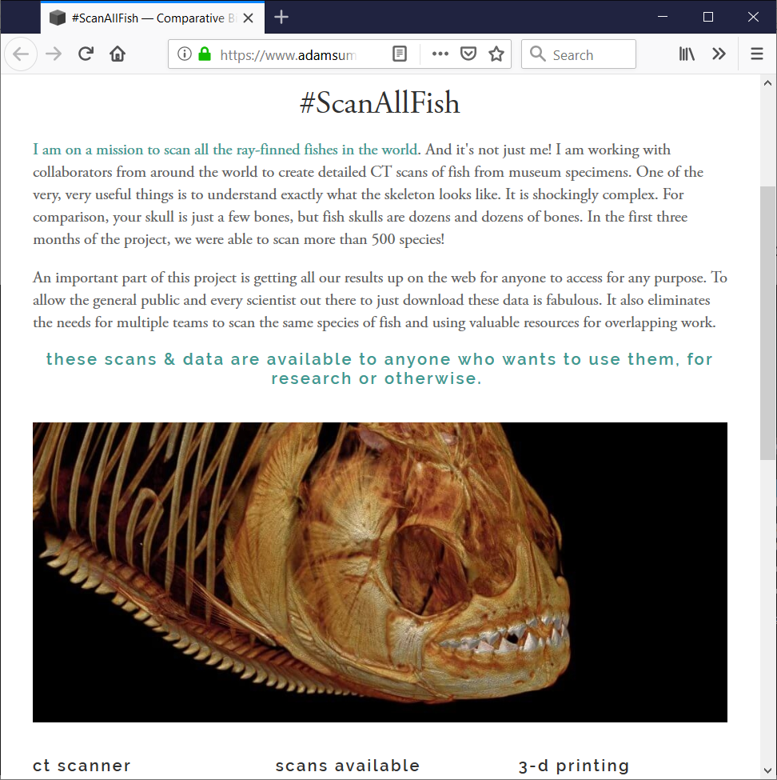
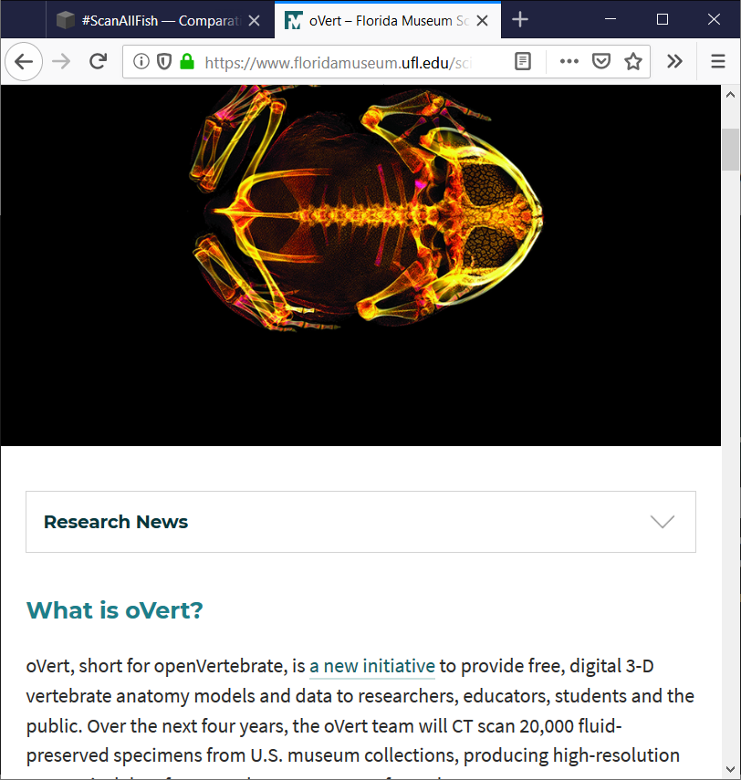
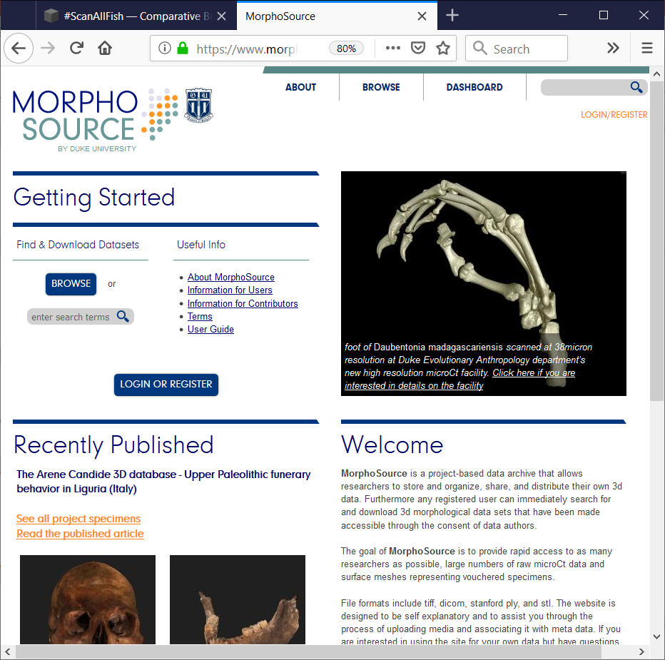
The final frontier
Open Vertebrate
MorphoSource.org
#ScanAllFishes
Notes:
And we are expecting to see an even bigger jump with the large collections of 3D specimens, and aggreagate specimen repositories like MorphoSource.

Slide 14
Morphometrics discussion list
https://groups.google.com/forum/#!forum/morphmet2
~1000 members from a global pool of scientists interested in using quantitative methods to analyze organismal shape and form.
Diverse body of interests: Ecologists, evo/devo biologists, systematists, paleontologists, anthropologists and biomedical researchers.
Motivating question: “I want to analyze shape variation patterns in XYZ species... I found datasets in MorphoSource / DigiMorph etc….., but don’t know what to do”.
Notes:
But there is a disconnect between this ever increasing available specimen data, and the type of the questions we are seeing on the international morphometrics listserve. Typical question would ask I found 3D scans of the species my interested, but I don’t know how to make 3D picture, or collect landmarks, or some fundamental question that was an issue when I was a graduate student 10-15 years ago, but shouldn’t be anymore. Or people buying VG Studio or Mimics or other expensive software only to take some 3D measurements of their specimens.

Slide 15
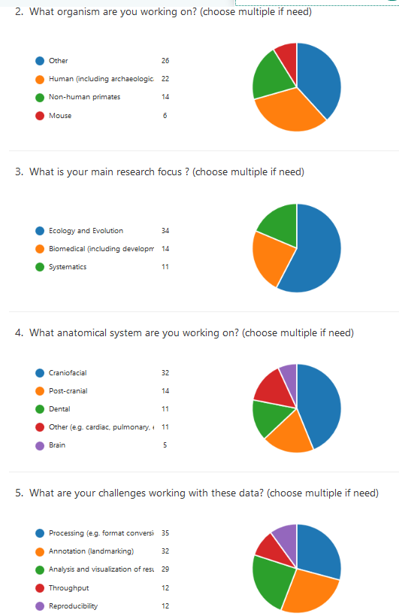
Survey of 3D morphometrics
A survey for people who are working (or planning to work) with volumetric datasets (CT, MR, and likes).
Challenges identified were:
Data wrangling (converting formats)
Annotation (measurements)
Analysis and visualization
Notes:
So I ended up running a survey to identify challenges that people face working with 3D data. Surprisingly what people are stumbling most was at the fundamental level (data conversion, collection, etc).

Slide 16
A typical workflow:
Download data from one or more of the repositories in different formats and/or modalities.
Find a software that will enable 3D visualization/segmentation and conversion to mesh, then landmark digitization (commercial software like Aviso, Mimics, Geomagics, Analyze, or free ImageJ, 3D Slicer, ITK-Snap)
Export landmark data into a format that can be understood by the analysis software.
Analyze using R (or MorphoJ)
Export results back to the digitization software to visualize (may not be necessary for everyone).
Notes:
Each of these steps can be error prone and frustrating. Our goal is to minimize these steps.

Slide 17
SlicerMorph Project Organization
SlicerMorph Core Team:
Lead-PI: Murat Maga (UW / Seattle Children’s)
Co-PI: Adam Summers (UW FHL)
Co-PI: Doug Boyer (Duke Evol. Anthropology & Director of MorphoSource.org)
Consultant: Steve Pieper (Isomics Co., Chief Software Architect of 3D Slicer)
Lead Developer: Sara Rolfe (UW FHL & SCRI)
SlicerMorph Advisory Committee:
James Rohlf (Stony Brook U)
Dean Adams (U Iowa)
David Polly (Indiana U)
Anjali Goswami (Natural History Museum, London)
Collaborative Proposal: ABI Development: An Integrated Platform for Retrieval, Visualization and Analysis of 3D Morphology From Digital Biological Collections (ABI 1759883, 1759637, 1759839) 08/01/2018-07/31/2021
https://nsf.gov/awardsearch/showAward?AWD_ID=1759883&HistoricalAwards=false
Notes:
Slicer Morph is not your usual research grant. It is aimed at working with 3D specimen and sharing data easier while increasing the knowledge base of the community.

Slide 18
SlicerMorph Road Map
We just finished year 1. Current grant ends in 08/2021:
Implement Generalized Procrustes Analysis (GPA) and PCA visualization of shapes
Data import tools (IDAV Landmark, morphologika, Bruker/Skyscan)
Documentation, virtual office hours, and community forming
WIP for the on-going grant
5 intense workshops, one symposium, and bunch of half-day tutorials organized around major professional meetings (UW FHL)
Implement deformable grids/meshes for semi-landmarking
Implement landmark-free correspondence (auto3Dgm) between shapes (Duke)
Better integration with MorphoSource
Minor support tools
Optimize the GPA UI
We are essentially a bridge between the core Slicer Developers and biosciences community.

Slide 19
SlicerMorph Road Map
Pending grant with Kitware to Chan-Zuckerberg Initiative:
Lots of software re-engineering for working with large datasets (>10 Gigavoxels)
Better H/W capability detection and user guidance
Complex animations based on keyframes (more on this later in the labs)
Easier deployment of Slicer on cloud platforms or virtualized environments.
(you get to have a test of it during the workshop, if you like)
For SlicerMorph2:
Seamless integration with R (geomorph specifically) for modeling and domain specific analyses (i.e., phylogenetics, quantitative genetics etc)
Cloud-based platform for data analysis, visualization and collaboration
But future is dependent on the community input and engagement.
Notes:
We are here to understand your needs, and how you can best accomplish them using open-source software. We may not have answers for everything, but we will find resources that will put you on track.

Slide 20
Workshop Resources
SlicerMorph website: https://SlicerMorph.github.io
Sign up for announcements' and updates: http://bit.ly/SM-listserv
Course lectures and labs: https://github.com/SlicerMorph/S_2019
Data upload link: https://faculty.washington.edu/maga/data_dropbox/
(provide a short description of what you uploaded and your email)
Download sample data (same set as the one in your usb drives):
https://seattlechildrens1.box.com/v/S-2019-DataSets
Notes:
Also sign up for SlicerMorph announcement email list (low traffic 5-10/yr) http://bit.ly/SM-listserv

Slide 21
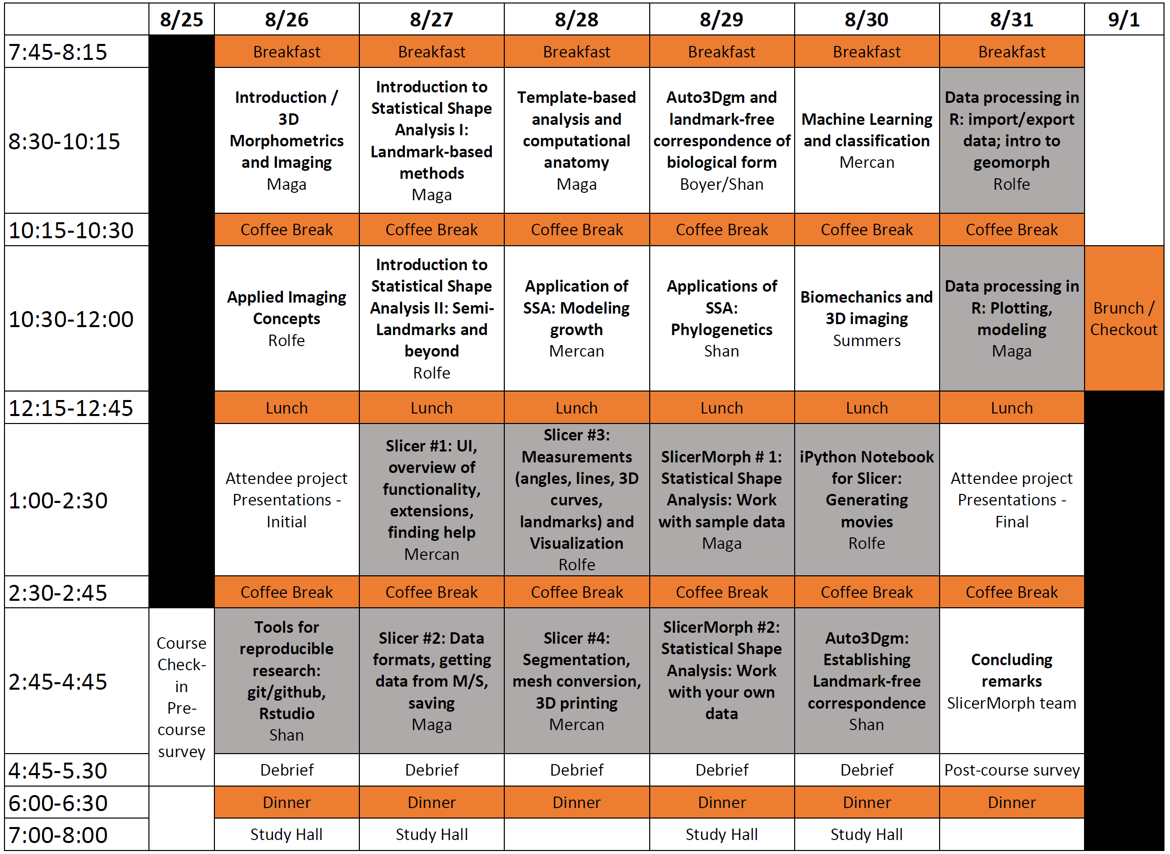
Overview of the week
Notes:
This is our first iteration, and you are our guinea pigs. In this iteration, I decided to go for breadth of coverage instead of depth. We most of the topics we included as lectures are actually quarter long courses on their own. We will try to summarize the
Review schedule (flexibility especially in Saturday).
First time, feedback (both real-time and post-course evaluations) will be tremendously important. We are very broad in terms of coverage
Lightning talks this afternoon (box share to upload them PDFs are preferred).
No debrief, but just hangout as a group to answer questions
A plan for this evening to meet at brew pub after dinner 7p. Wait for updates.
Social event/Group photo, rowboat training.

Slide 22
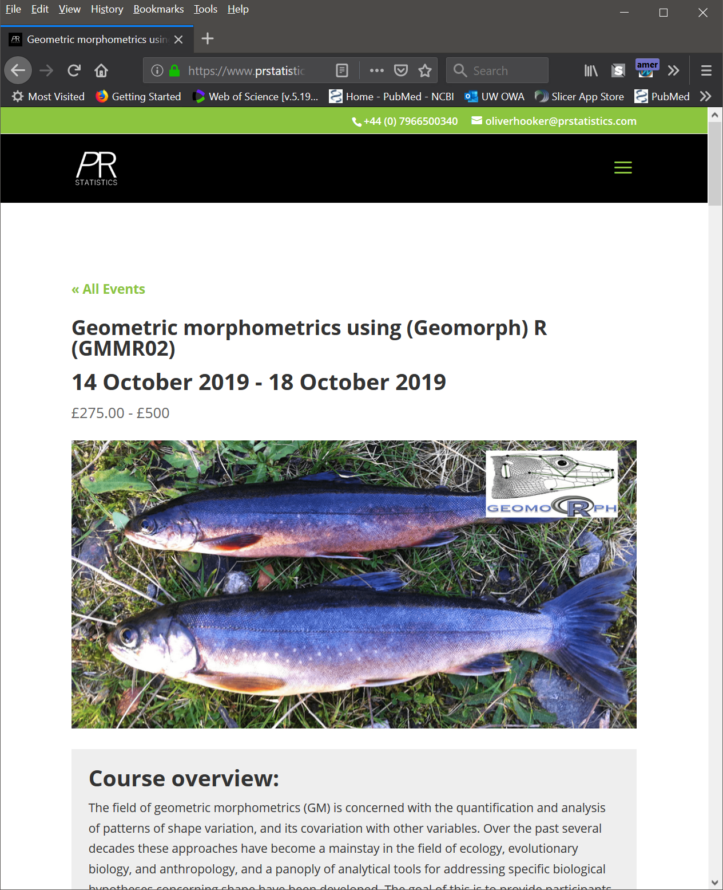
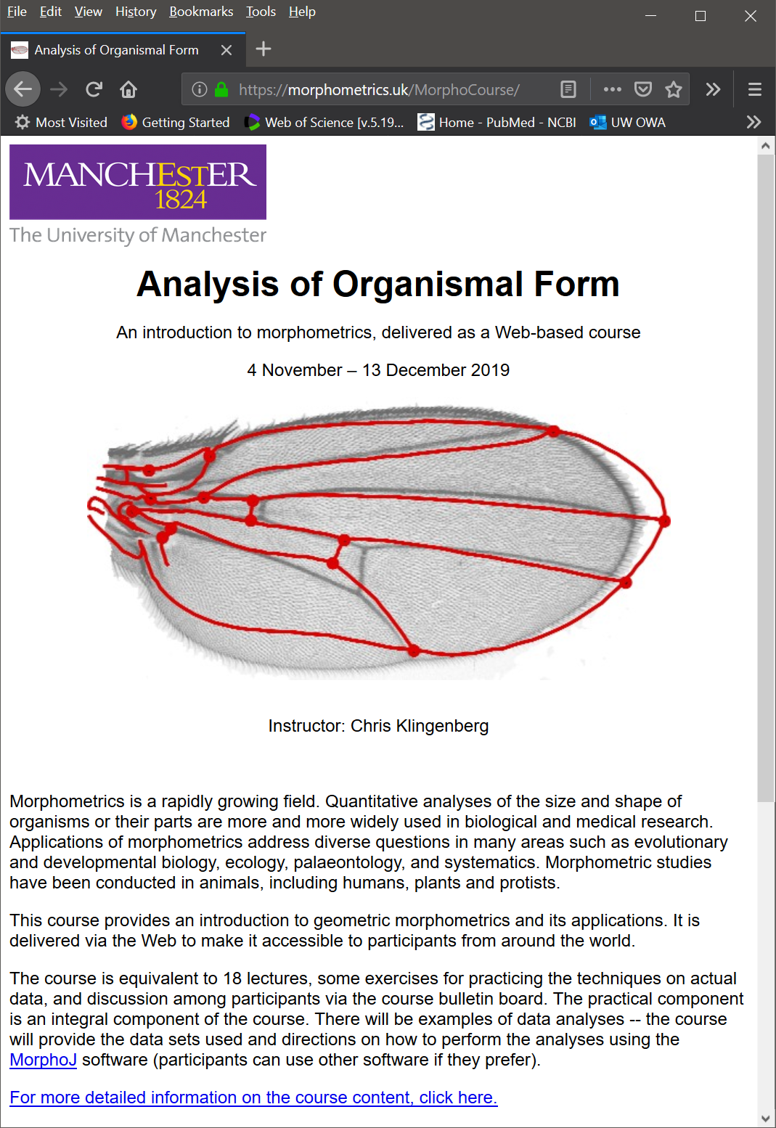
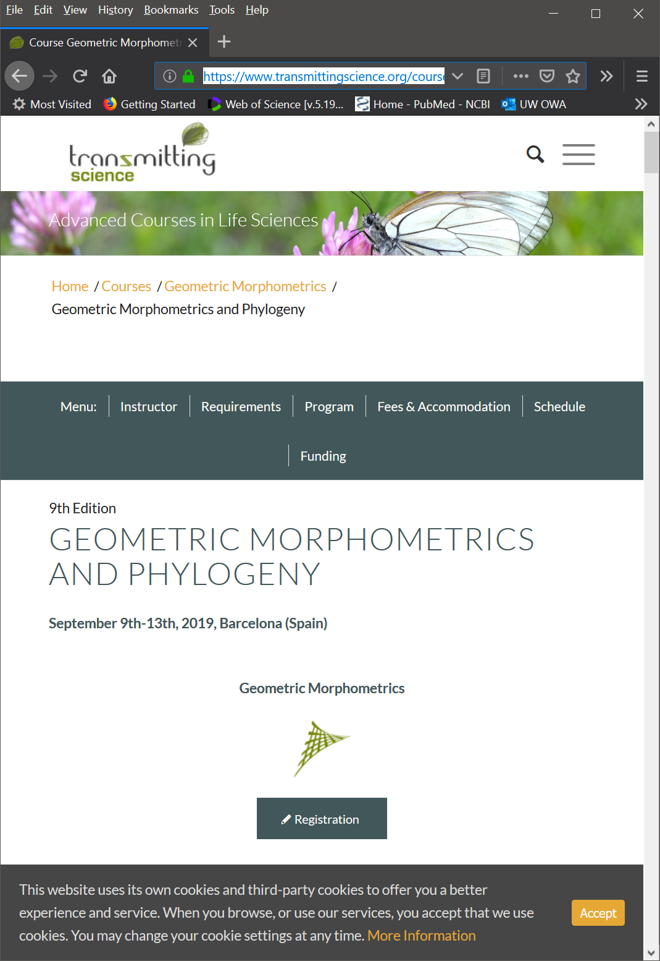
Upcoming Geometric morphometrics specific short courses
https://www.prstatistics.com/course/geometric-morphometrics-using-r-gmmr02/ (Dean Adams)
https://morphometrics.uk/MorphoCourse/ (Chris Klingenberg)
https://www.transmittingscience.org/courses/geometric-morphometrics/geometric-morphometrics-phylogeny/

Slide 23
Course package:
Evaluation forms: We need your feedback both right at the end of each lecture and lab. Please return to them to the collection box right after the lecture/lab. There will be a survey for overall feedback at the end of the course (Saturday PM).
Follow up survey: We will contact you in 3-4 months for a brief survey.
Username and password: If you need/want to connect to the remote server from your lab. (instructions at: https://github.com/SlicerMorph/S_2019/blob/master/remote.md)
Notes:
*
* Even if you are not planning to use VNC, we would like you to give it a try. We are contemplating a proposal in which there can be a cloud-based resources for data generation, analysis and visualization. What you will be using remotely will be a component of it, and we can use feedback

Slide 24

Slicer/SlicerMorph Champions
“Volunteer” someone from your lab to be the resident-expert.
Write and share SOPs on the SlicerMorph website (it is a git repository)
Develop tutorials/use cases

Slide 25
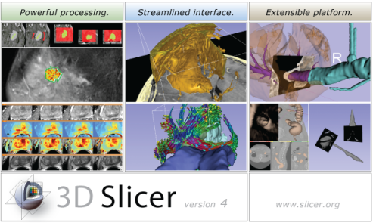



Background for 3D Slicer
Software application for medical image computing: data import/export, visualization, segmentation, registration, quantification, real-time guidance
Application framework: customizable, extensible custom modules
Completely free (BSD)
Multi-platform
User and developer support
Training courses, documentation, tutorials
Fedorov, et al. "3D Slicer as an image computing platform for the Quantitative Imaging Network." Magnetic resonance imaging 30.9 (2012): 1323-1341.
Notes:
Valley of death: Slicer does not fit traditional science funding mechanisms:
Science agencies: its not innovative
Companies: no proven clinical utility, too risky

Slide 26
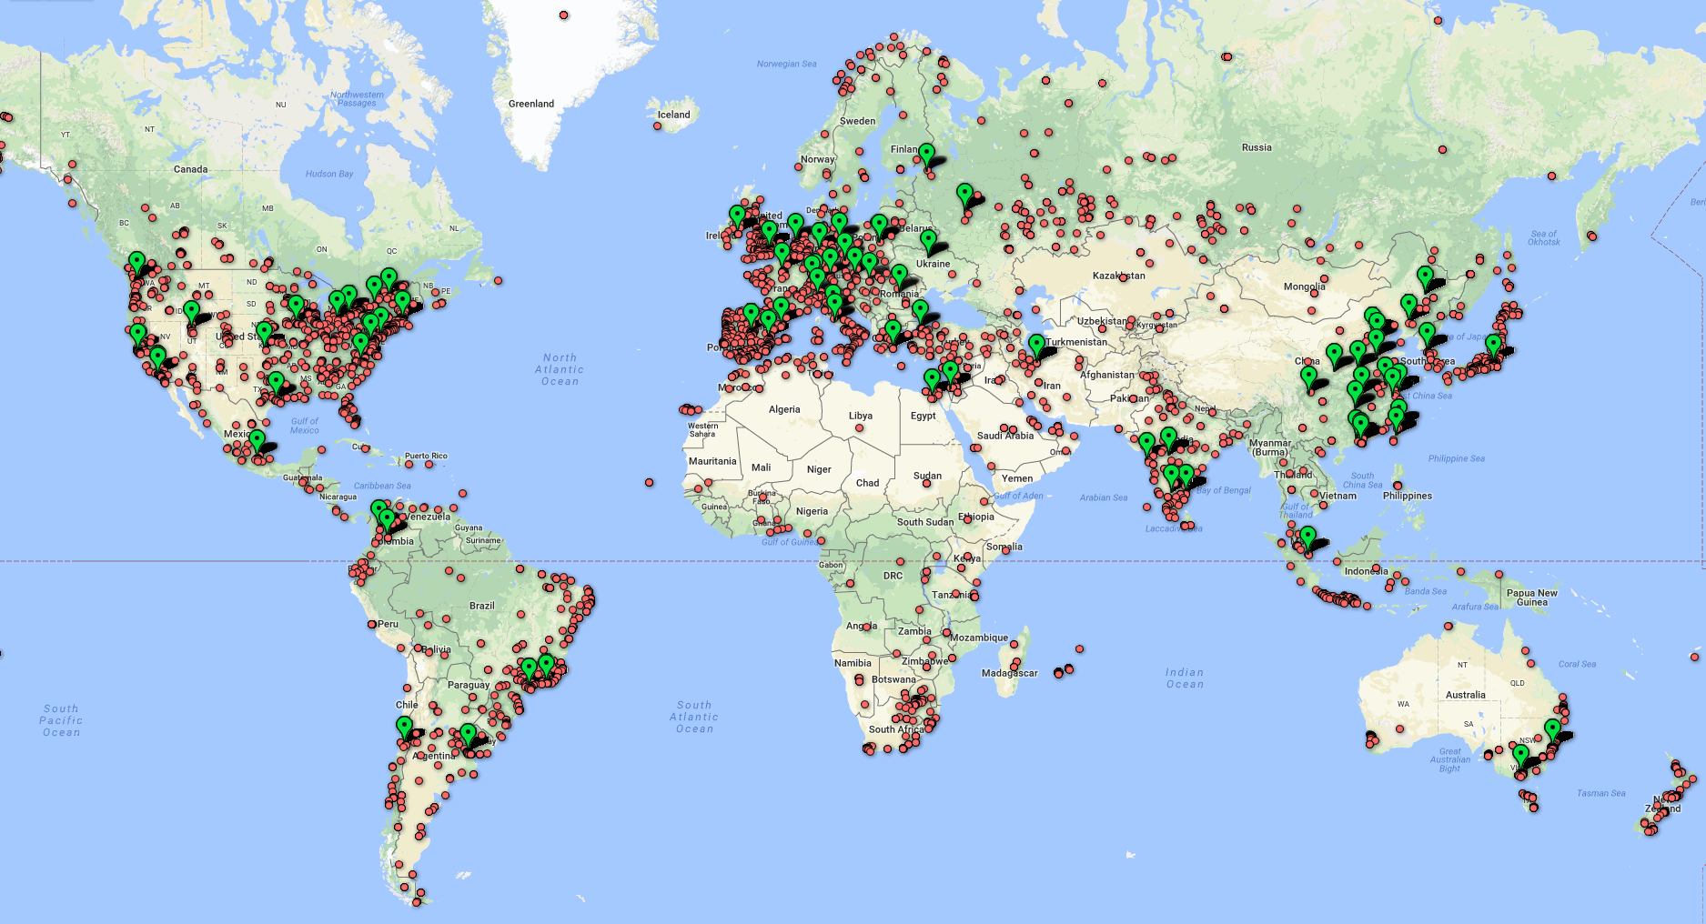
Large user community
500 downloads per week in 2012
2800 downloads per week in 2018
330 000+ downloads over the past 5 years:
Notes:
And as you can see, Slicer has a similarly sized user base here in Europe as in North-America.

Slide 27
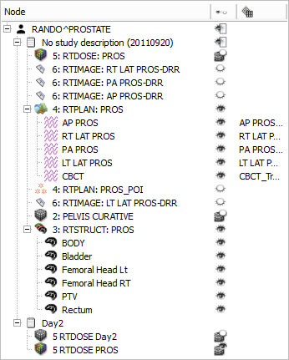
Data import/export
DICOM: 2D/3D/4D volumes, structure sets, dose volumes, etc. (extensible without Slicer core changes)
Research data formats for volumes, meshes, transforms (NRRD, MetaIO, VTK, HDF, etc.)
Common non-medical data formats (JPEG, TIFF, etc.)
Save and complete restore of application state
Notes:
Slicer supports many ways of importing and exporting data that one wants to visualize:
1. Through the DICOM (is a standard for handling, storing, printing, and transmitting information in medical imaging.) importer (which supports … )
2. Common research data formats
3. Basic data formats
Additionally, it is also possible to, at anytime, save the entire application state in order to restore the complete application state at a later time. (US ELEPHANT DEMO?)

Slide 28
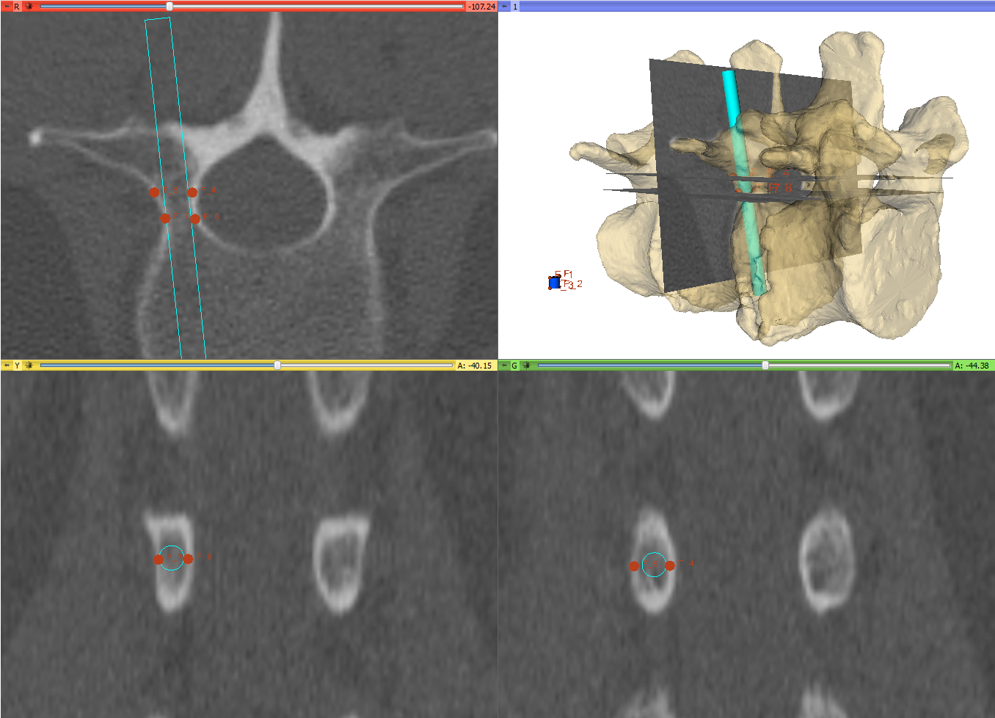
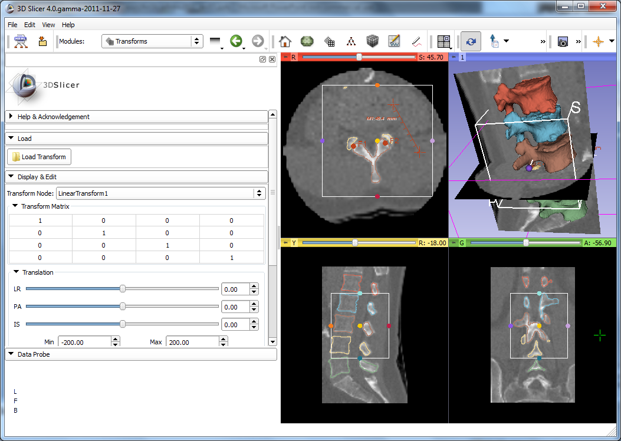
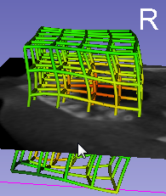
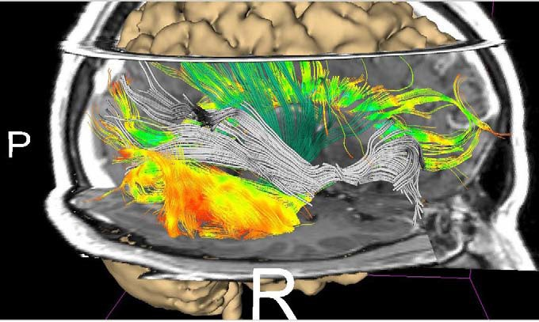
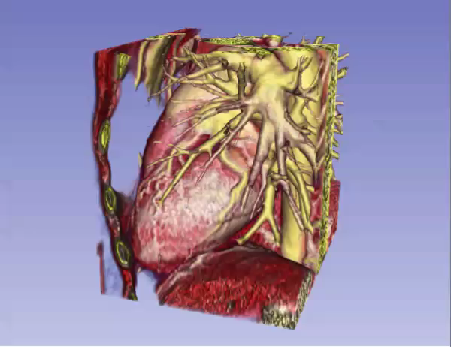
Extensive Visualization Capabilities
2D (slice) and 3D views, chart views
Configurable layout
Multi-modality image fusion (foreground, background, label map)
Transforms, vector and tensor field visualization
Surface and volume rendering
Time sequence data
1
2, 3
4
5
6
Notes:
A multitude of options for visualization are available in Slicer (1,2,3,4,5,6).

Slide 29
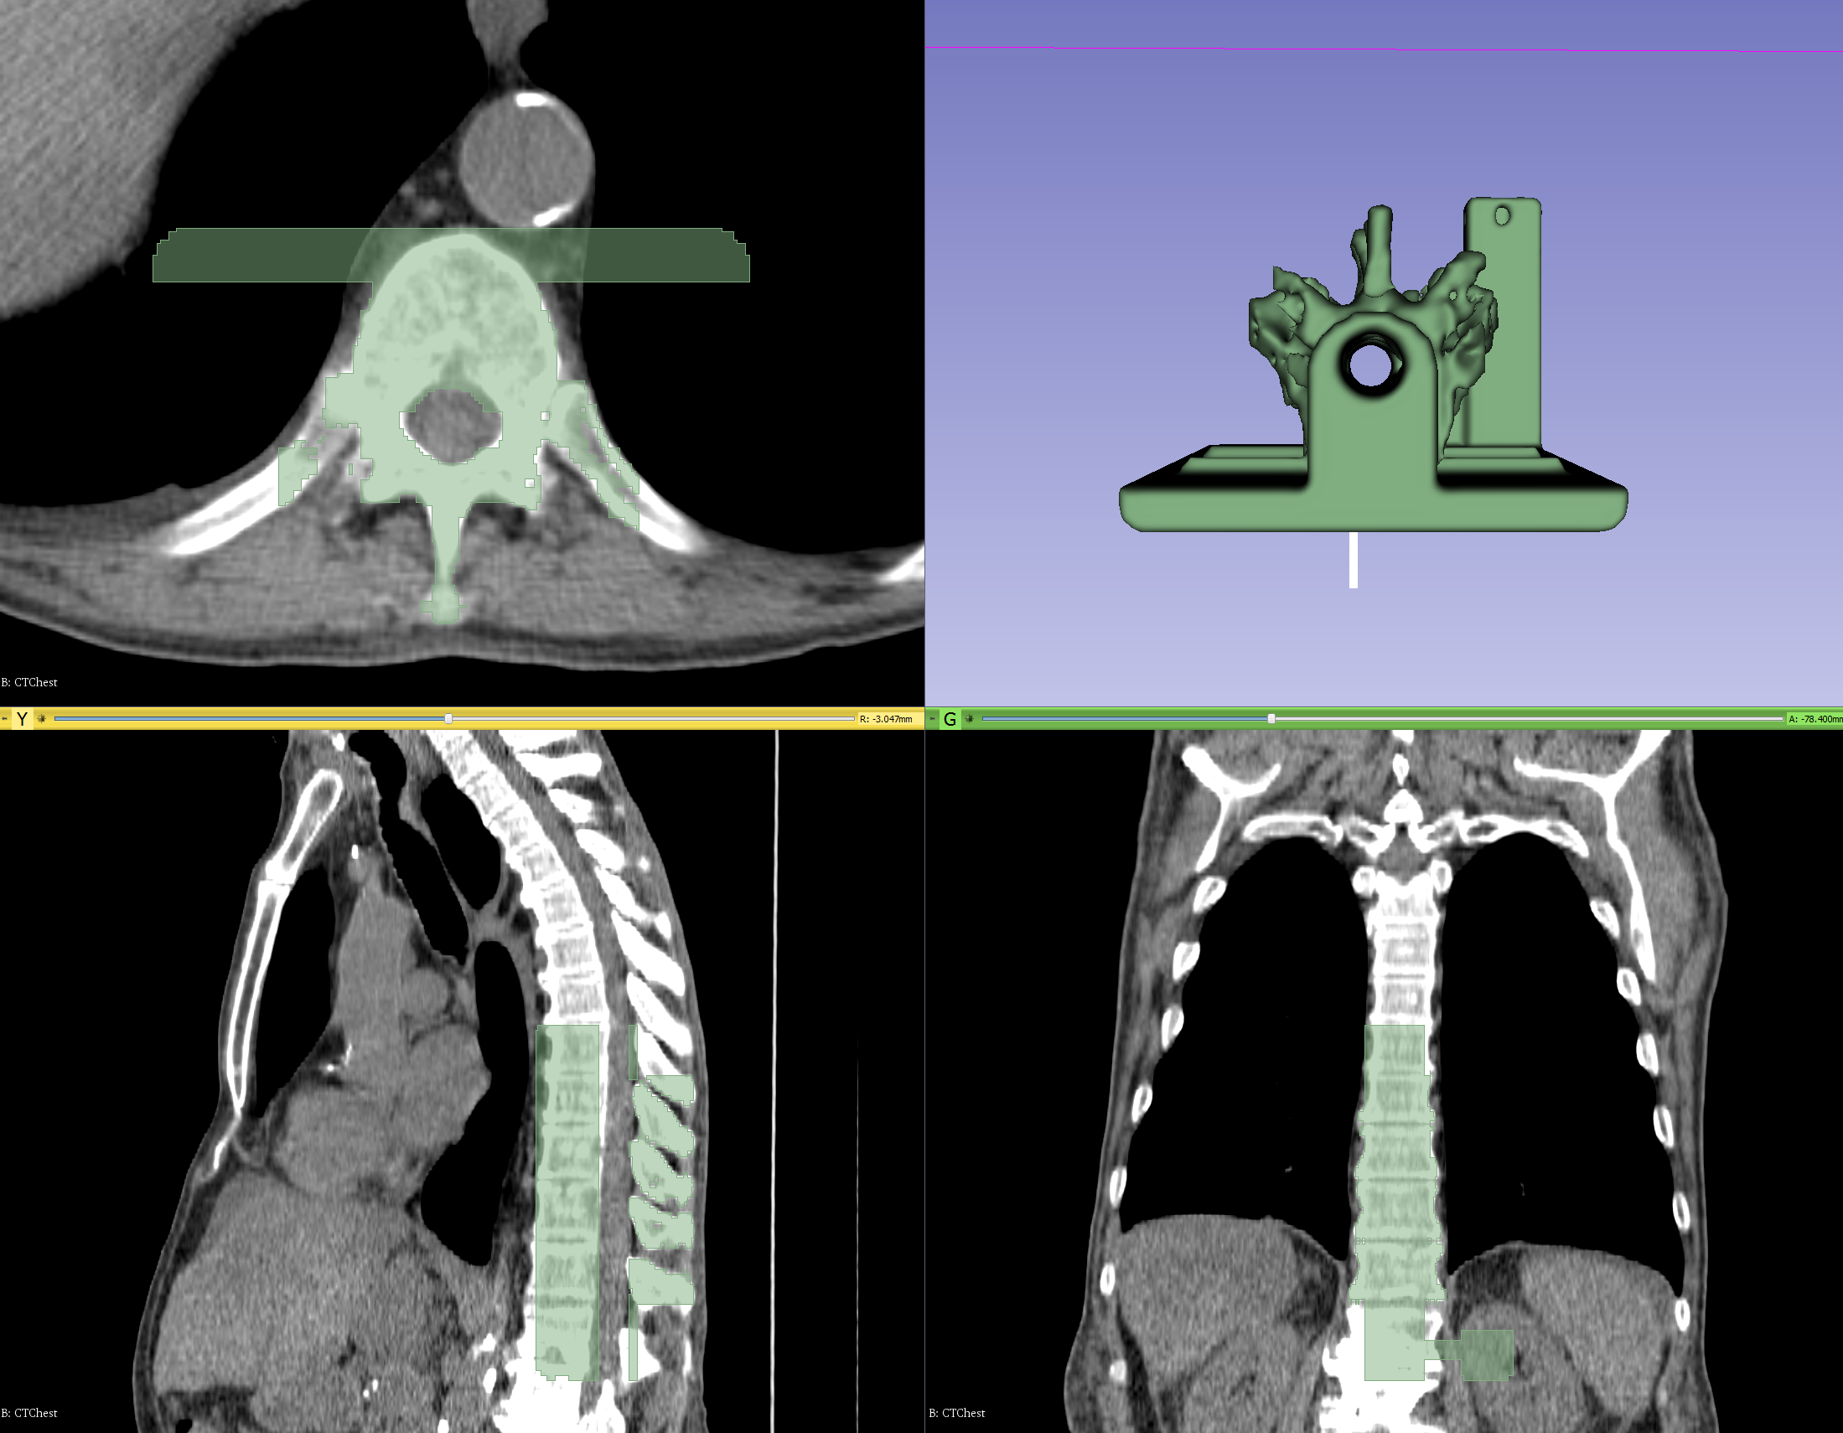


Segmentation
Manual (paint, draw, scissor, threshold, etc.)
Semi-automatic (region-growing, fill between slices, etc.)
Automatic (atlas-based, robust statistics, etc.)
Notes:
As for the common task of segmentation (which means to divide an image into multiple parts which is typically used to identify objects), Slicer supports both manual approaches (like contouring and painting) as well as automatic (like region-growing and atlas-based).
The Slicer screenshot here shows a segmented prostate in the Editor module where many of these tasks can be performed.

Slide 30





Annotations (Landmarks, Lines, Angles, Curves, Planes)

Slide 31

Data Tables, Plots, and statistics (w/ Python)

Slide 32



Registration
Manual: translation, rotation in 3D
Automatic: rigid, deformable, with various similarity metrics, initialization methods, optimizers, masking, etc.
Extensions: structure-based registration, Elastix, etc.
Notes:
As well as registration (which is the process of transforming different sets of data into one coordinate system, i.e. aligning images)
These are prostate MRI images, taken during MRI-guided robot-assisted prostate biopsy procedure; Slicer registers the high-resolution planning volume (acquired at the beginning of the procedure to plan biopsy targets) to the lower-resolution confirmation volume (acquired after the needle is inserted). The registration compensates for patient motion.

Slide 33
What’s inside Slicer?
Slicer core: Slicer GUI, I/O, visualization and developer interfaces
Slicer modules: internal plugins that depend on the slicer core
Slicer extensions: external plugins installed on demand by the user

Slide 34

Slicer is extensible
The Slicer Extension Manager offers the possibility to the user to download and install additional Slicer modules

Slide 35
Data handling: the MRML scene
MRML: Medical Reality Modeling Language
All objects (volumetric images, surface models, transforms, etc.) are stored in a hierarchical structure of MRML nodes
Each MRML node has its own list of custom attributes that can be used to specify additional characteristics for the data object
Enables the modules to have access to the MRML tree, allowing new extensions to leverage existing processing and visualization functions without directly interfering with other modules

Slide 36
Python in Slicer
The Python console of Slicer gives access to
Scene objects (MRML)
Data arrays (volumes, models)
GUI elements (Qt) that can be encapsulated in a module
Processing Libraries (more can be installed)
numpy
VTK
ITK
CTK

Slide 37


Without an application platform
Building on an application platform
Each application is developed from ground up
Completely new software is developed for each problem/procedure/device
Significant work is needed to integrate new, advanced algorithms
Core functionalities are already implemented
New software modules can be developed for specific needs
Many new, advanced algorithms are available
Well-supported with a large user and developer community
Quick start.
Huge waste of time, money, and effort overall.
Investment at the beginning: learning.
Minimal wasted efforts.
Notes:
Because, without an application platform
Show animations
On the other hand, if you are building your work on a pre-existing application platform
1. Portable (Win, Linux, Mac), Open-source

Slide 38
Benefit of open-source development
In the event of loss of funding, or the developer losing interest (or the ability) in maintaining the software, there is nothing for community to keep the software up-to-date (or even available as-is because of technology changes).
In open-source model, even if the core development group loose funding, disband or change focus, the community have access the full source code and any one else can pick up the development or maintain as it is in perpetuity.
It is particularly appealing for publicly funded projects.

Slide 39
Challenges of open-source development
Usually not as ‘finessed’ as the commercial software.
Users have to engage with developers. There is usually no phone number to call, but a community support system*
Priorities of multiple and geographically separated developer groups may clash and create conflict**
Open source licenses can be incompatible (e.g., bioformats in Slicer)
Up until now development of Slicer has been mostly through research being conducted on clinical datasets. MicroCT, CryoEM, 3D light-sheet microscopy have the potential to change that.
Notes:
* I would argue Slicer community support is actually better than most paid support service
** Slicer community have semi-annual project weeks to overcome such challenges and find solutions to such conflicts (rodmaps etc).

Slide 40


... In the end, to help yourselves you do need to know some basic concepts of open-source software development (this afternoon’s lab)
https://www.youtube.com/watch?v=9GBekYcJR4E

Slide 41
But Slicer doesn’t work with my datasets!!!
On 64-bit Oses, Slicer is only limited by the hardware capabilities of your system:
However:
All operations in Slicer are done in-memory. I.e., you need to have more quite a bit more memory than your dataset (more on this later). You can address this in two ways:
Buy as much memory as your H/W will support (typically 64-128GB for i7 processors)
Increase the virtual memory on your computer (everything will work but will be quite slow).
For 3D rendering, you need to have GPU that’s capable of displaying large 3D texture dimensions and have lots of GPU memory (e.g., TITAN RTX will load datasets up to 24GB). A 2080TI (about 1/3rd of price of TITAN) is more than sufficient for most datasets.
Datasets are sacrosanct, Slicer will NOT do anything to your data until you tell it to do explicitly

Slide 42
But I can’t get my data into Slicer!!!
Slicer uses open volume formats by default. (We will see more in detail in Lab4).
Have your imaging center provide the original scan in DICOM or TIFF stacks.
If you have already done work in a software with proprietary software, see if you can export it into one of the common formats.
If not, see the company provide documentation on their format (especially problematic for microscope data). You can then describe the data to Slicer using NHDR format of Nearly Raw Raster Data format. Or we/developer community can possibly develop an import plugin that other can benefit too.
Try the rawImageGuess extension (https://github.com/lassoan/SlicerRawImageGuess)
Try the Bioformats plugin from Open Microscopy (available in Fiji).

Slide 43
How big of a dataset I can work on with Slicer?
Depends on what you want to do:
Rule of thumb 6-10X more RAM than your dataset size.
E.g. 1024x1024x1024 scan with intensity ranges from 0-4096 would be 2GB when loaded
Depending on the type of the action, RAM requirement would be 4-20GB.
Most filters and tasks Slicer is multi-threaded, thus would benefit from multi-core computer architecture
If you do registration, requirements would approximately double.
3D Volume Rendering (Raycasting) needs a high-end GPU with more memory than your largest dataset.
So, example above would work on a GPU with 3GB GPU RAM.
It also depends on your GPUs OpenGL hardware capabilities (check https://opengl.gpuinfo.org/ )
CPU rendering always works, but usually slow (unless you have dozens of cores).
You can use downsample or crop your volume to match it to your hardware.
Keep your data as a 3D volume. Reading one large files is faster compared to reading thousands of small files.
NVME SSDs are very good investments.

Slide 44
3D scans to 3D meshes
In general avoid mCT-> polygon mesh conversion, unless your analytical software calls specifically for geometry (e.g., auto3Dgm). Because:
Image intensity information is useful and necessary for certain tasks (e.g., registration, segmentation)
Volume rendering of a volumetric scan is typically superior to the 3D rendering of meshes derived from the same scans.
Most importantly for landmarking you do NOT need meshes (unless your data comes from surface scanners). In fact, one of the benefits of volumetric scan is to be able to look at cross-sections (e.g., endocranial landmarks), which would be difficult with meshes.
If you do need meshes, do the conversion yourself by knowing each of the steps involved and what it does to the data.

Slide 45



Don’t believe everything you see.

Slide 46

3D specimens are same thing as museum specimens
You wouldn’t work on random specimens without provenance information
Why would you work with random 3D meshes on internet?
(metrological quality, what was the segmentation pipeline, etc)
Our goal is to teach you the basic concepts of image manipulation so that you can do all necessary steps on your own using Slicer (or other software of your choice).
When you publish results/scans, consider making the raw image (scan) data available as part of it (e.g., MorphoSource).
Notes:
Sketchfab.

Slide 47


Data acquisition: 2D, Cephalometry

Slide 48


Data acquisition: 3D Photo-stereogrammetry

Slide 49



Data acquisition: Volumetric scans (MR, CT, CBCT)
MRI
CBCT
CT

Slide 50

3D Fluorescent Microscopy Revolution

Slide 51
Key Point
SlicerMorph is not a regular research project, but a chance to build a community for people working on 3D Morphometrics around Slicer.
https://faculty.washington.edu/maga/data_dropbox/

Slide 52

Acknowledgements
Extended SlicerMorph Team
Sara Rolfe (UW/SCRI, Lead Developer)
Doug Boyer (Duke, SlicerMorph Co-PI)
Julie Winchester (Duke, MorphoSource)
Adam Summers (UW, SlicerMorph Co-PI)
Steve Pieper (Chief Software Architect of 3D-Slicer)
Slicer Developer Community
Funding
NSF-Advances in Biological Informatics
Murat Maga (Seattle Children's): Award #1759883
Adam Summer (UW): Award #1759637
Doug Boyer (Duke University): Award #1759839
SlicerMorph Advisory Board
James Rohlf (Stony Brook University)
Dean Adams (University of Iowa)
David Polly (Indiana University)
Anjali Goswami (Natural History Museum, London)

